Slide 1

Notes:
A logo might not seem like an important thing to create at this early stage.
However, developing a “working title” brand for your project will help unify the team under a banner and the process of creating one will help you find the essential flavour of your game.
Remember that strong presentation is essential to clear communication, particularly when the subject of your communication is speculative.
Give the audience something to remember here. Something that captures the feel you want your project to communicate.

Slide 2
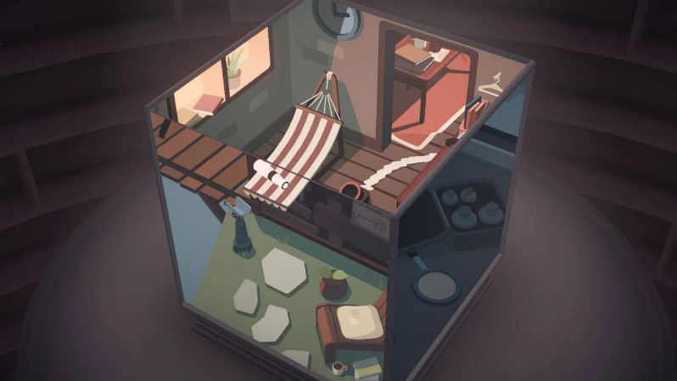
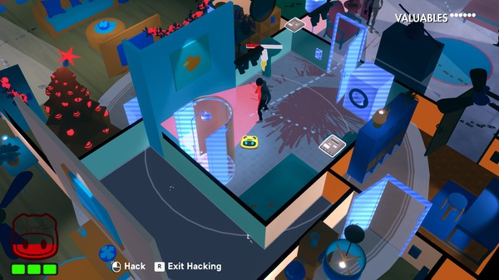
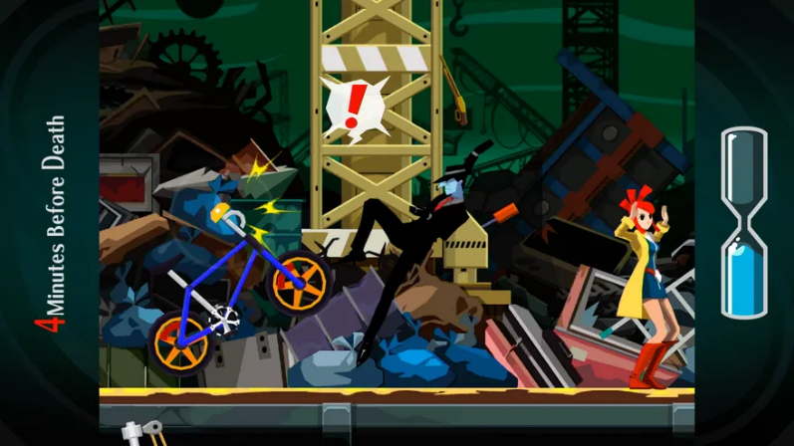
INGREDIENTS
+
+
Moncage
Roombo: First Blood
Ghost Trick: Phantom Detective
Puzzle Game
Low Poly
Rotating play area
Isometric environment
Interactive Household Appliances
Manic Hijinks
Interact with objects to affect the environment
Notes:
Find three “ingredients” that carry associations, or “flavours” that will help position your game in the minds of your audience.
These ingredients might be movies, TV shows, novels, music, apps or games. It’s a good idea to use a few different media types here, with very specific call outs to the flavours you want to confer on your project. Be careful if you choose to use games, as these carry inevitably subjective experiential expectations as well as flavours. You might want to extract the humour from Portal 2, but your audience will associate that ingredient with whatever their strongest memory of the experience of play was (mind-bending puzzles, first person perspective, female protagonist etc). Selectively managing these kinds of expectations is an important part of communicating your idea.
An example ingredient might be “Die Hard”. There are many flavours you could extract from such a well known cultural artefact. Hostages, Sealed Building, Lone Agent might be one set. Elevator Shafts, Air-Conditioning Ducts and Fire-Escapes might be another. The first set of ingredients suggests a narrative situation that might be a setting for a game. The second suggests a suite of level design components and infers game structure and mechanics. Ideally, your collection of ingredients and flavours will illustrate both.

Slide 3
THE GAME
Single Player, 3D puzzle adventure game
Play as a house AI in a 3D house.
Environmental manipulation
Manage electronics that have an impact on the environment.
Move through rooms via connected appliances.
The environment is a character. Levels develop in complexity
Common objectives / opposing mechanics
Try to manage the house and take care of living dependents (Plants, Pets and Humans).
Gameplay lies in the tension of keeping dependents alive till the end of the day.
Developed in Unity for PC
Keyboard and mouse as the method of interaction with the game
Notes:
Above is a sample scenario intended to give you an idea of the areas you might need to cover with this slide.
This slide should describe the game in succinct and direct terms. After reading it, your audience should understand the basic gameplay mechanic and the form the game will take.
Use active and direct language to communicate your idea in as few words as possible. This is nuts and bolts stuff and no place for adjectival word play or narrative explication.

Slide 4
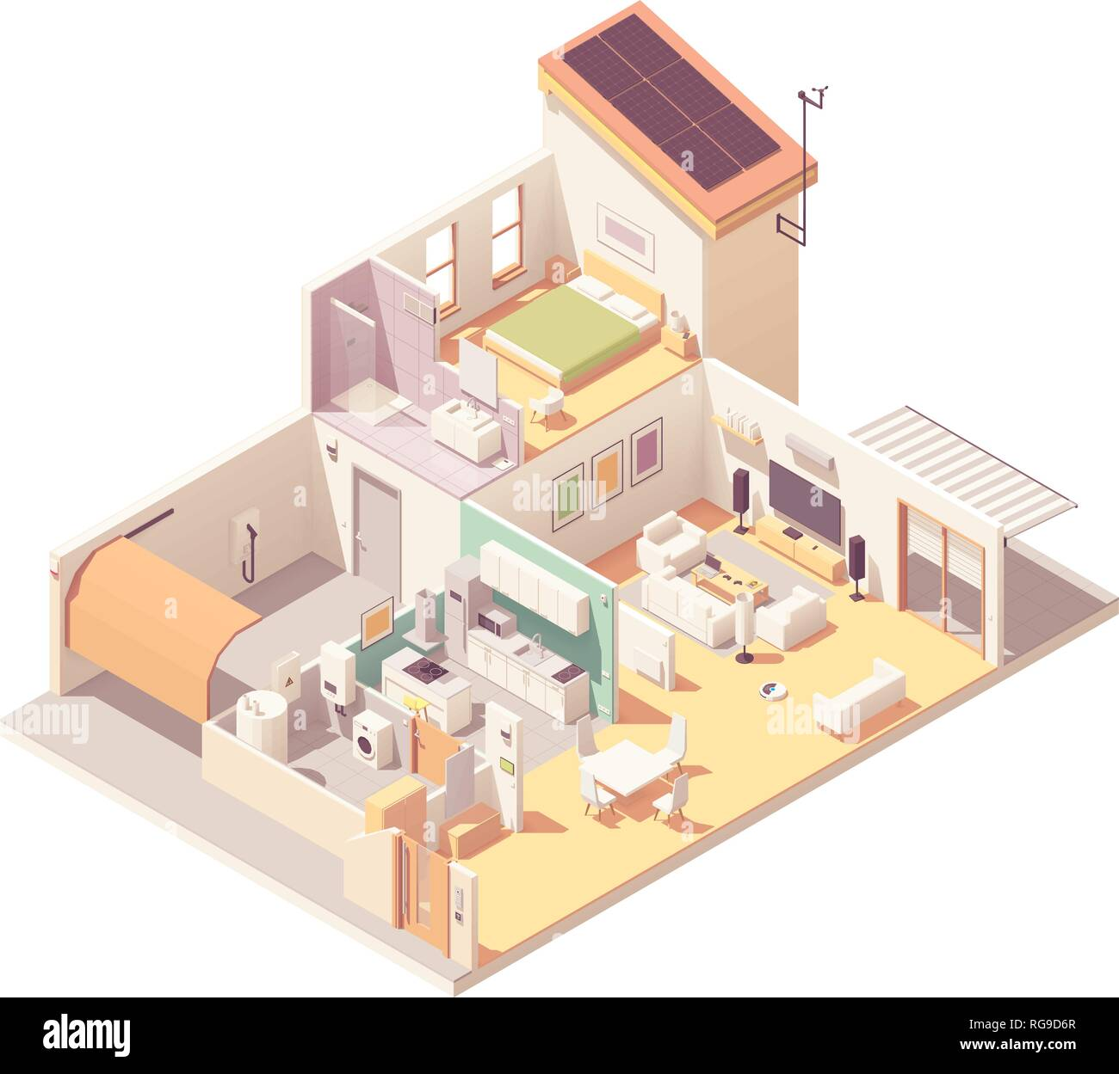


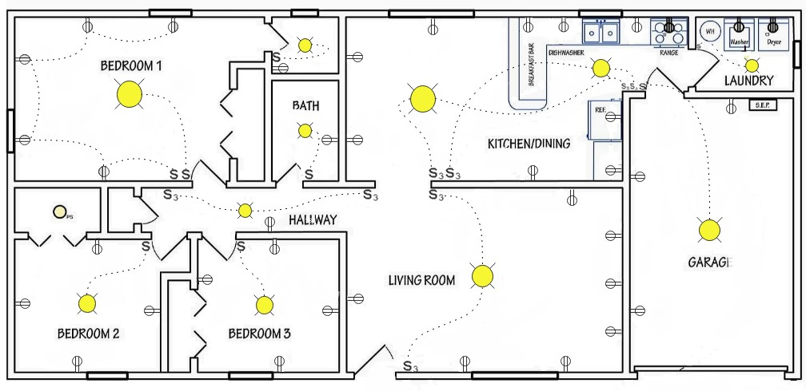
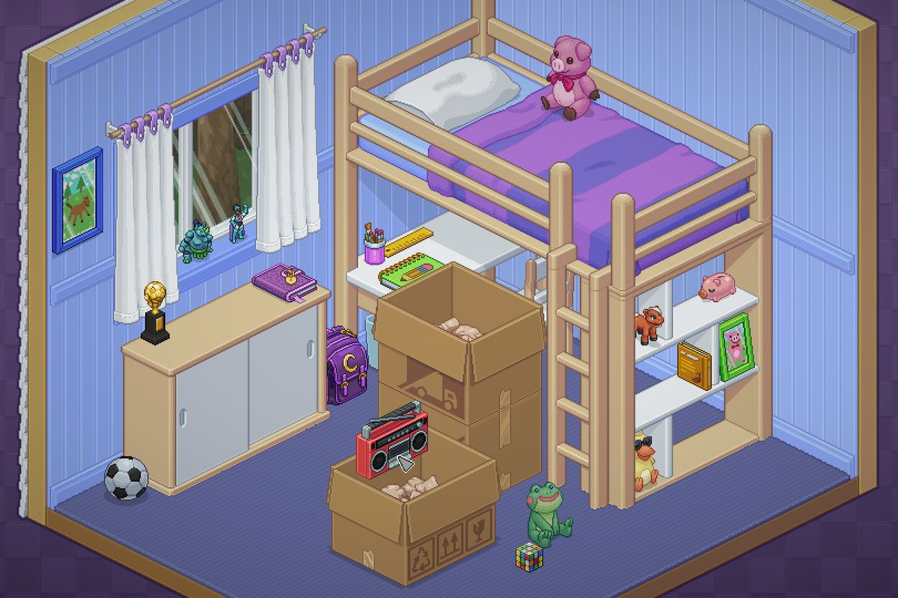
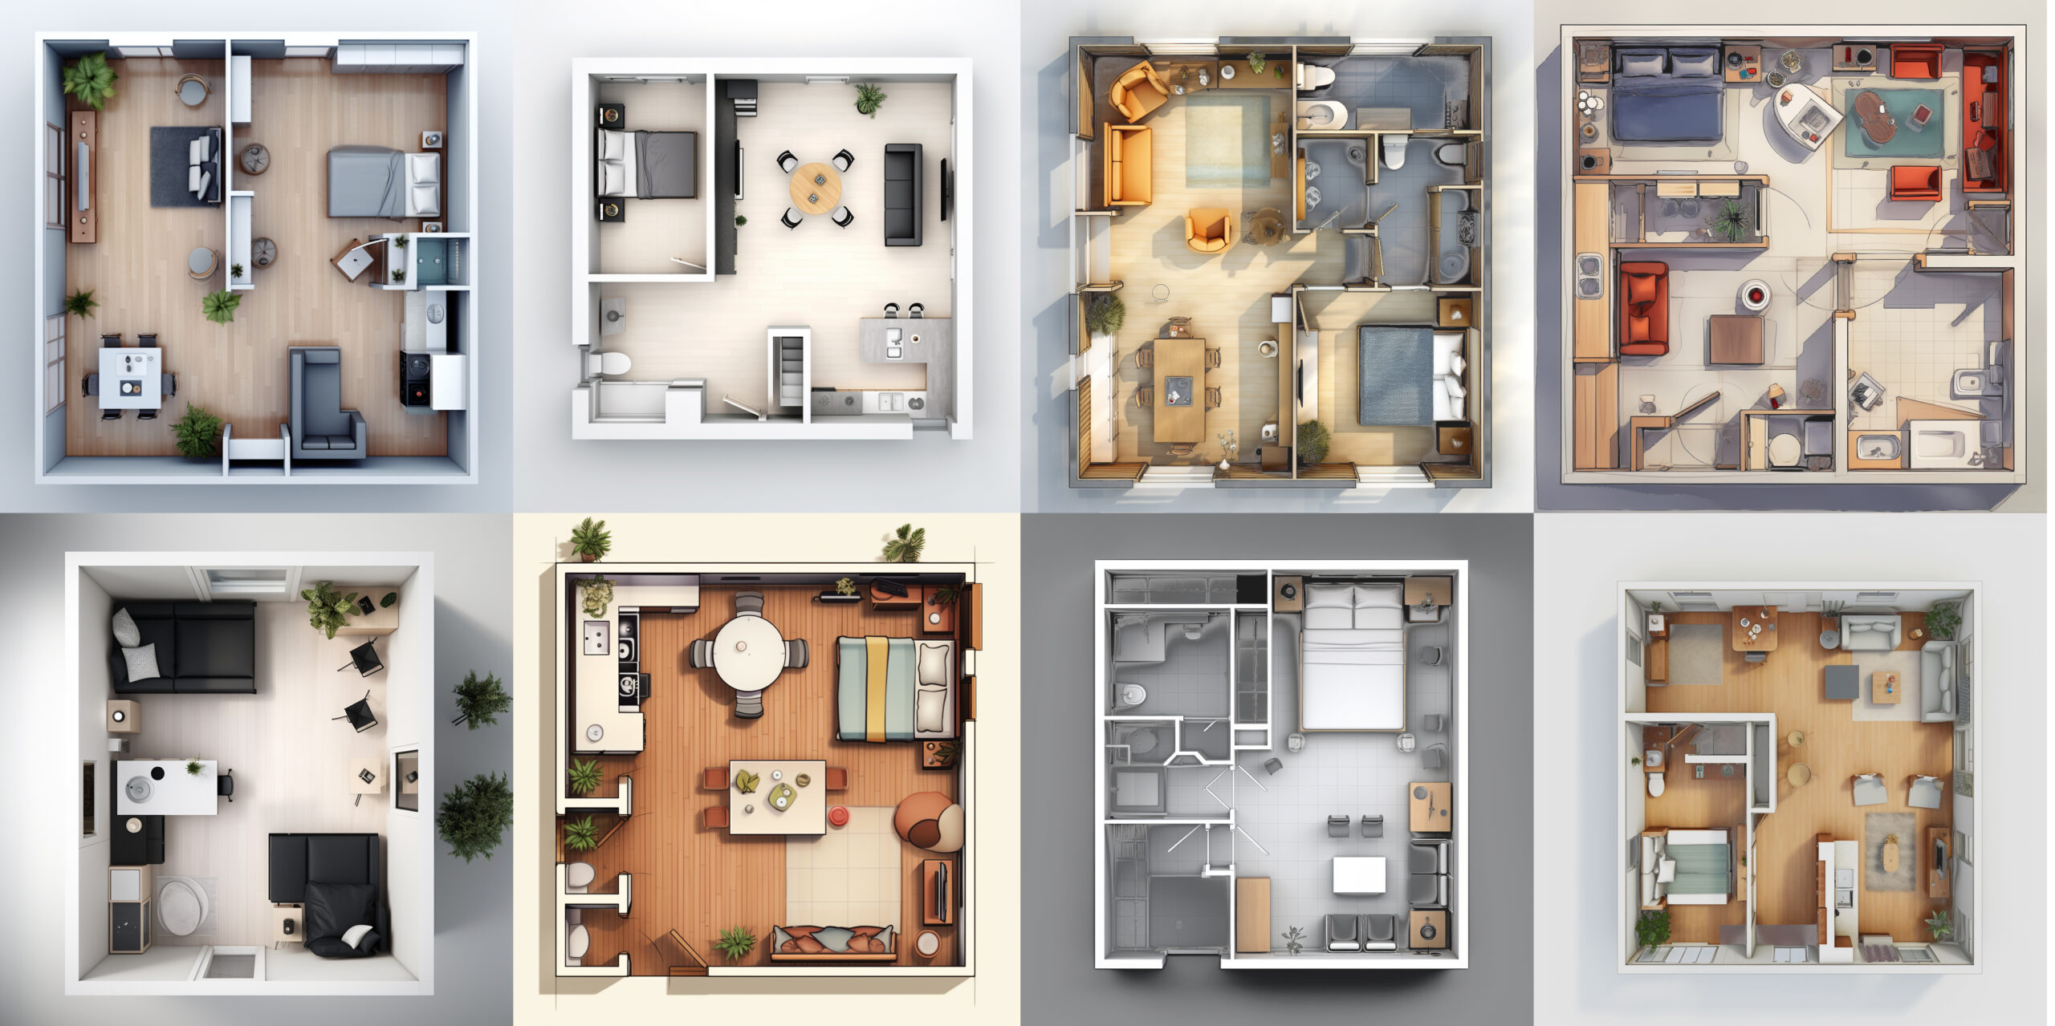
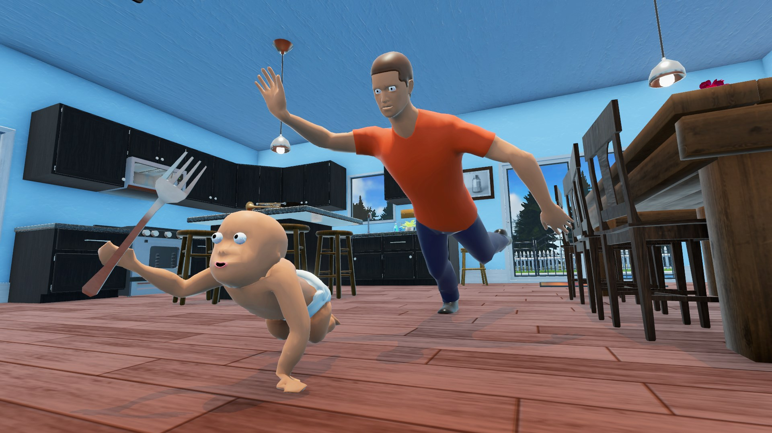
Notes:
Use montages of found and/or original images to create moodboards for your concept. Images communicate more immediately and conjure more intuitive and visceral associations in the minds of your audience.
Each moodboard should relate to the section of the document. In this case, The Ingredients and The Trailer. Use images that expand on and flesh out the points your trailer hinted at.
Consider using colour and recurring visual themes to group and/or separate ideas.
Use the “Moodboard.psd” supplied as a base for these slides. The grid is flexible (so change it!) and designed to work with a range of images in a variety of orientations and formats.

Slide 5
THE EXPERIENCE
Connecting / activating / deactivating
Interact with the environment to protect dependents
Master the appliances and interactions.
Race to keep the dependents from hurting themselves and each other.
Understand the relationships between house and human.
Discover which electrical connections interrupt others.
Balance human safety and convenience with power & connection allowances.
Notes:
Use this slide to describe the player experience. Use active (verbs) and persuasive language to deliver the feel you want your audience to take away from your presentation. Previous slides have described the exerience. This one sells it.

Slide 6
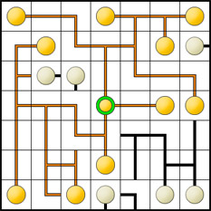
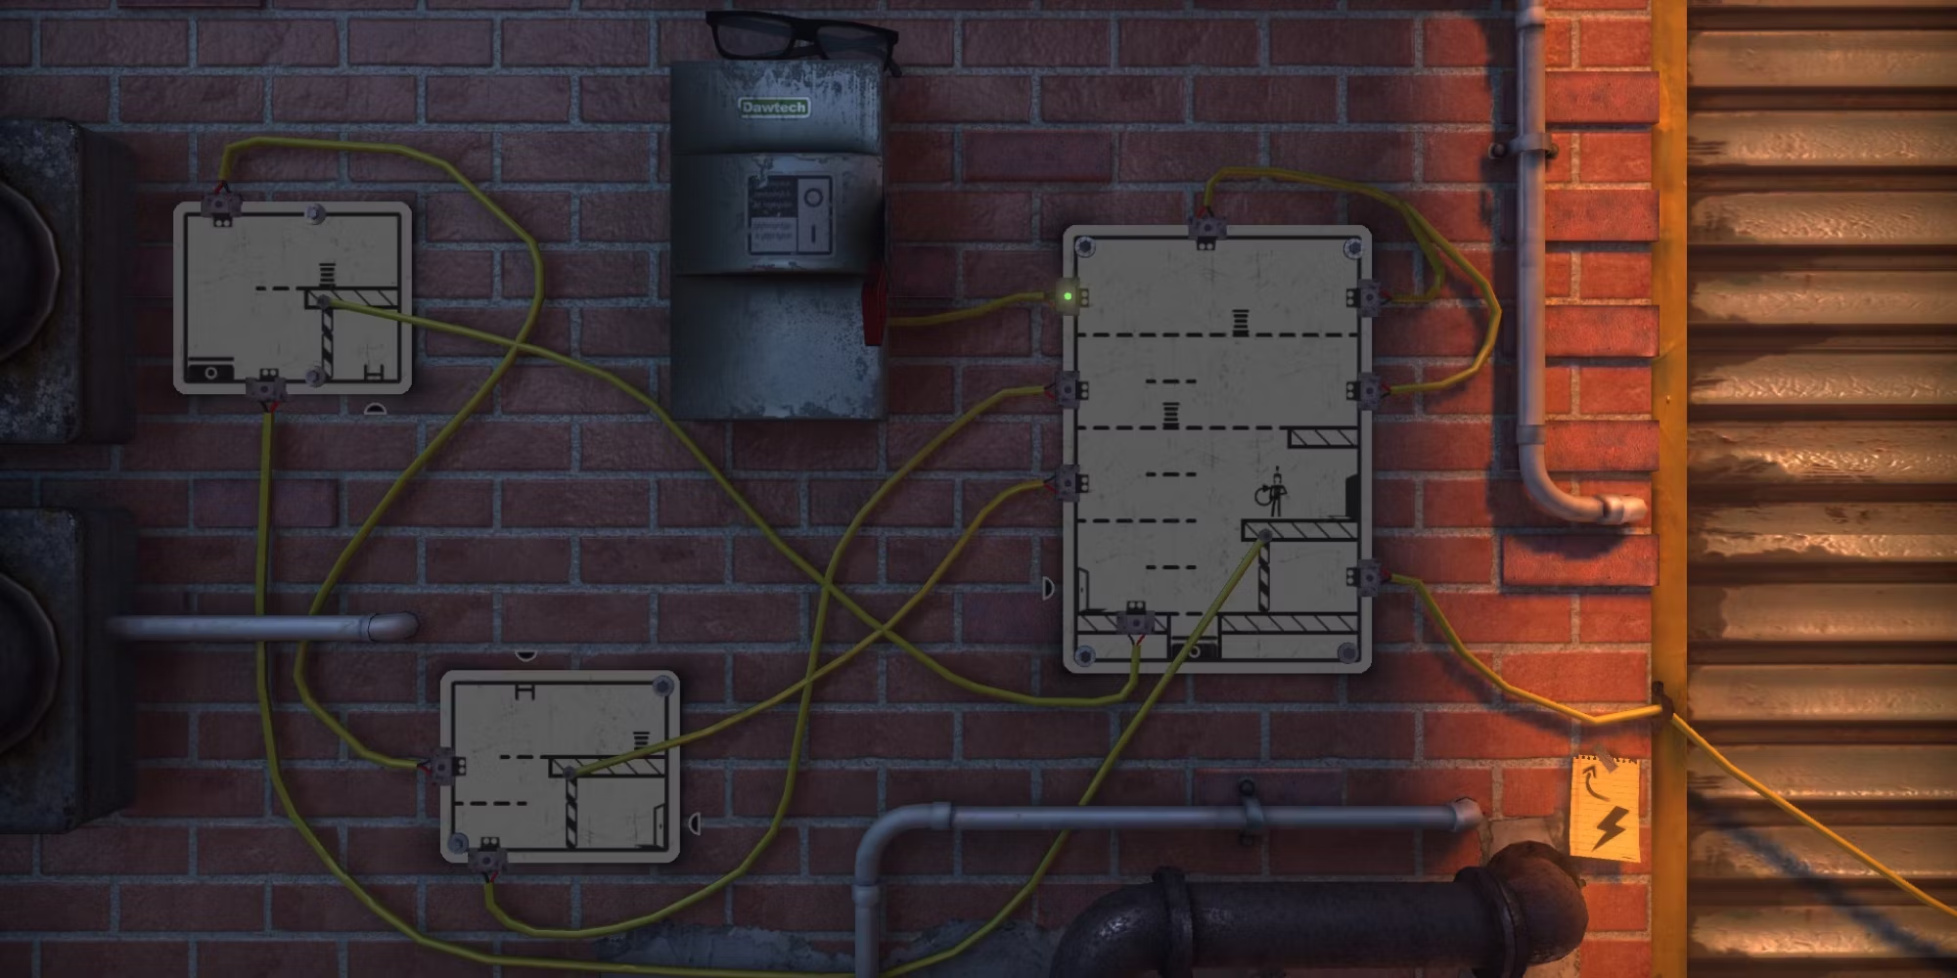
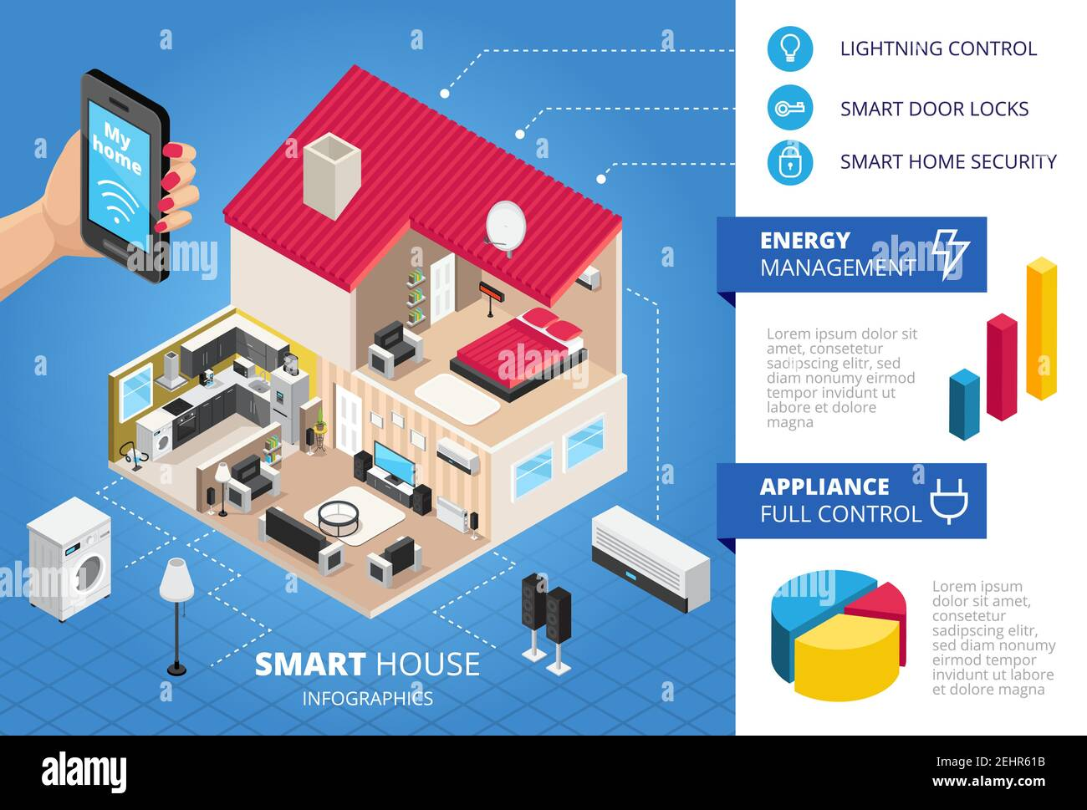

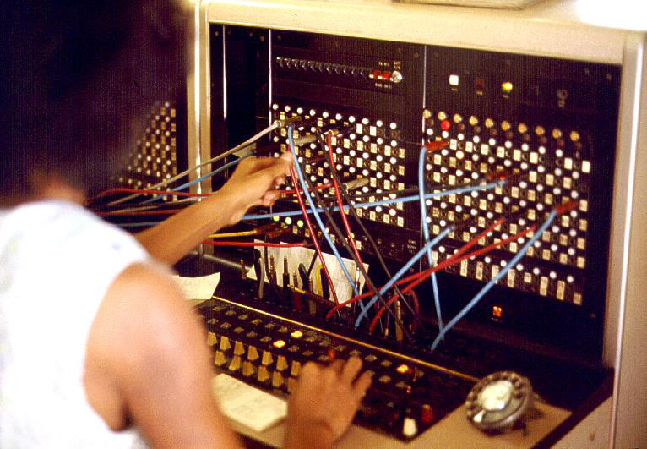
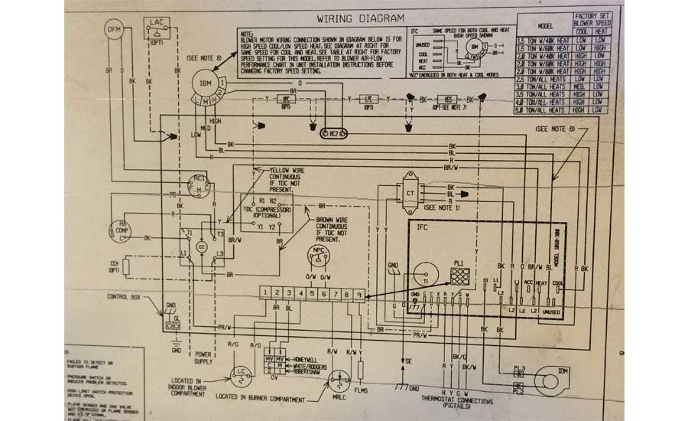
Notes:
Use montages of found images to create moodboards for your concept. Images communicate more immediately and conjure more intuitive and visceral associations in the minds of your audience.
Each moodboard should relate to the section of the document. In this case, The Game. Use images that illustrate some of the components referenced in that slide.
Consider using colour and recurring visual themes to group and/or separate ideas.
Use the “Moodboard.psd” supplied as a base for these slides. The grid is flexible (so change it!) and designed to work with a range of images in a variety of orientations and formats.

Slide 7
THE WORLD
The setting
A world where AI is being developed to help maintain households and the beings in it.
The characters
The player (AI)
The dependents: people, pets & plants
The house
The scenario
You play as an advanced AI brought into a household. As the game progresses you watch things that happen inside the house. The people grow and spaces change.
The complication
You begin switching on lights and unlocking doors. Due to your performance the homeowners introduce more compatible appliances for you to have access too.
Notes:
Use descriptive but concise language to explain the game world. If your game is defined by the setting or the relationships between characters, use this slide to expand on those aspects of the pitch. This, however, should be secondary and supplementary to your mechanical explanation of the project.
If your game has a more ludic and less narrative driven structure, then rename the slide and use it to explain aspects of the gameplay that didn’t fit in earlier slides.

Slide 8
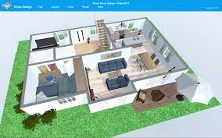
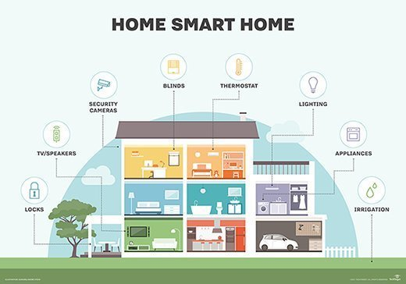
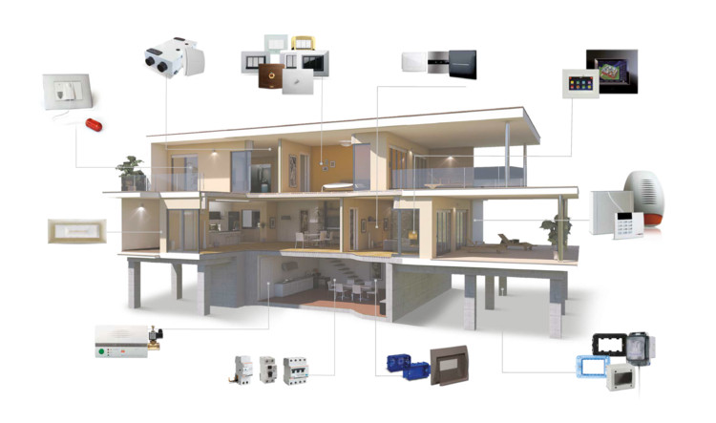
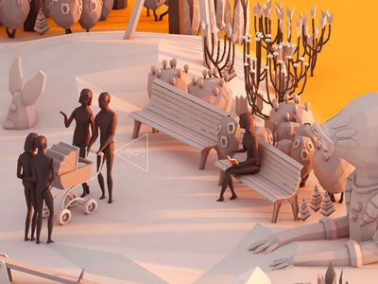
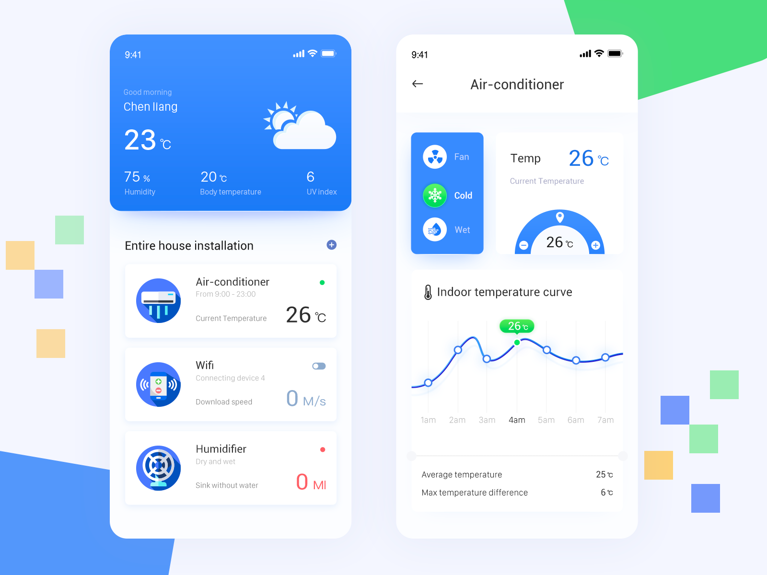
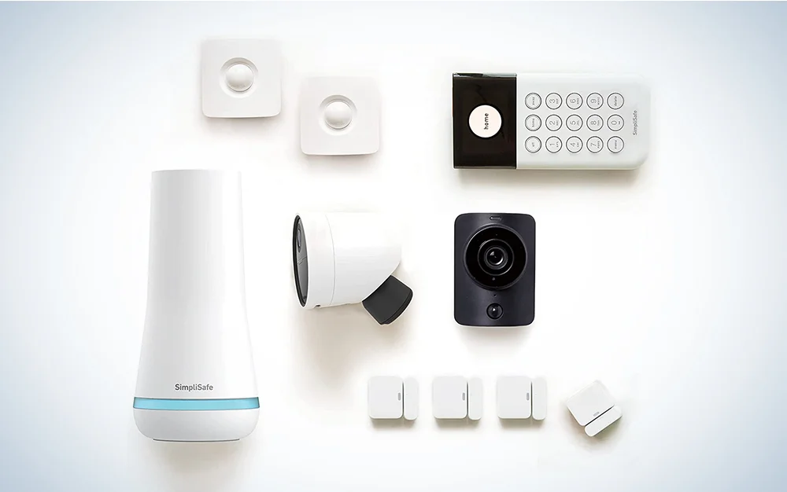
Notes:
Use montages of found images to create moodboards for your concept. Images communicate more immediately and conjure more intuitive and visceral associations in the minds of your audience.
Each moodboard should relate to the section of the document. In this case, The Experience and The Fiction. Use evoke the experience and expand on the fiction.
Consider using colour and recurring visual themes to group and/or separate ideas.
Use the “Moodboard.psd” supplied as a base for these slides. The grid is flexible (so change it!) and designed to work with a range of images in a variety of orientations and formats.

Slide 9
REFERENCES
[ Wider points of reference and inspiration for this pitch … ]
Novels or texts
Films or TV shows
Games
Unpacking: Environment changes telling the story of the protagonist.
Who’s Your Daddy: Concept of being responsible for another’s wellbeing.
Notes:
These references are secondary to the Ingredients previously listed. Consider adding media properties that didn’t make the Ingredients cut, but that are still important to an overall understanding of the flavour of your game.
References like this are useful hooks for your audience, and often inspire a sort of conspiratorial complicity between presenter and audience.
This is about bringing people into your world through a shared experience.

